Slide 1


Full Stack Development: A Comprehensive Guide
This presentation explores full stack development. We will cover its core components. You will gain a clear understanding. It's a versatile skill.
by Omar Falah

Slide 2

What is Full Stack Development?
Complete Coverage
It combines both front-end and back-end. Developers manage all project aspects.
Broad Skill Set
Proficiency in many technologies is key. This enables building dynamic web apps.

Slide 3

Front-End Development (Client-Side)
User Interface
Modern Frameworks
Focuses on UI and UX. Technologies include HTML, CSS, JavaScript.
React, Angular, Vue.js enhance development. Ensures responsive design for all devices.

Slide 4






Back-End Development (Server-Side)
Server Logic
Manages server, application, and database logic.
Core Languages
Languages include Python, Java, Node.js, PHP, Ruby.
Frameworks
Express.js, Django, Ruby on Rails are common.
Functionality
Handles data, security, and APIs. Powers dynamic web features.

Slide 5



Databases
Data Management
Database Types
Popular Choices
Use Case
Stores and manages application data. Ensures persistence and integrity.
Relational (SQL) and Non-Relational (NoSQL) exist.
MySQL, PostgreSQL, MongoDB, Cassandra are widely used.
Storing user profiles and preferences is a prime example.

Slide 6






Servers and Infrastructure
Hosting
Web Servers
Cloud Platforms
Servers host applications. They deliver content to users.
Apache, Nginx handle HTTP requests.
AWS, Google Cloud, Azure offer scalability.
Availability
Infrastructure ensures application availability.

Slide 7









The Full Stack Ecosystem
Front-End
Back-End
User interface and experience.
Server and application logic.
Servers
Databases
Hosting and content delivery.
Data storage and management.
APIs facilitate communication. Full stack developers orchestrate these components. This creates a seamless user experience from client to server.

Slide 8
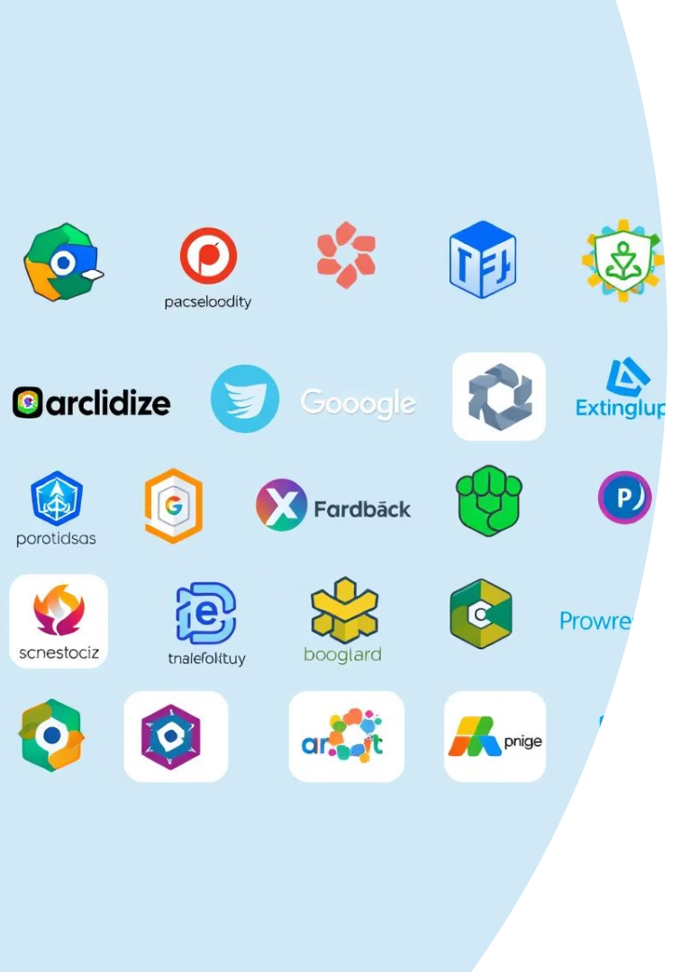

Popular Full Stack Technologies
1
MERN Stack
MongoDB, Express.js, React, Node.js.
2
MEAN Stack
MongoDB, Express.js, Angular, Node.js.
3
Python/Django
Python back-end, Django web framework.
4
LAMP Stack
Linux, Apache, MySQL, PHP.
Choice depends on project needs. Developer expertise also plays a role.

Slide 9





Benefits of Full Stack Development
Versatility
Handle diverse project requirements.
Efficiency
Faster development, reduced coordination.
Autonomy
Greater control over applications.
Career Growth
High demand.

Slide 10





Conclusion
Full stack development offers a holistic approach. It creates robust, scalable web applications. Mastery of front-end, back-end, databases, and servers is key. Continuous learning and adaptation are crucial for success.

